Slide 1


Slide 2
Introduction
Hardship and poverty go hand in hand. Flint is just one of the many impoverished cities in the United States. Flint’s downward spiral began in the late 1970’s. Flint experienced a severe downturn when General Motors downsized it’s workforce in the city from 80,000 to under 8,000 by 2010. Since then, Flint’s population has continually dwindled over the years.
What are some of the overriding factors that contribute to a failing community? Income, Housing, Health and Education are some of the ways to measure the overall well being of a community. Today, we will tell a story of Flint township through the data we collected.

Slide 3
Questions we raised about our topic:
What is the Median Household Income for City of Flint vs The state of Michigan vs the US?
What is the Median Income Per Capita for City of Flint vs The state of Michigan vs the US?
What are the types of Household that make up the city of Flint?
What are the Age Demographics for Flint?
How does home value affect the poverty we see in Flint?
What is the percentage of homes that have access to broadband internet? How does that affect education? If there is a significant portion of the population without access then how does that factor into a perpetual cycle of low income?
What is the percent of people in poverty in the city of Flint vs the state Michigan vs the Us?
What is the percentage of people without health insurance in Flint compared to the state of Michigan and the US?
What is the percentage of people with a disability in Flint compared to the state of Michigan and the US?
What is the percentage of people with a High School Diploma and Bachelor’s Degree in Flint compared to the state of Michigan and the US?

Slide 4
Resources
We were able to locate data for Flint, Michigan, and the United States at the following websites.
United States Census Bureau
Census Reporter
Data USA

Slide 5
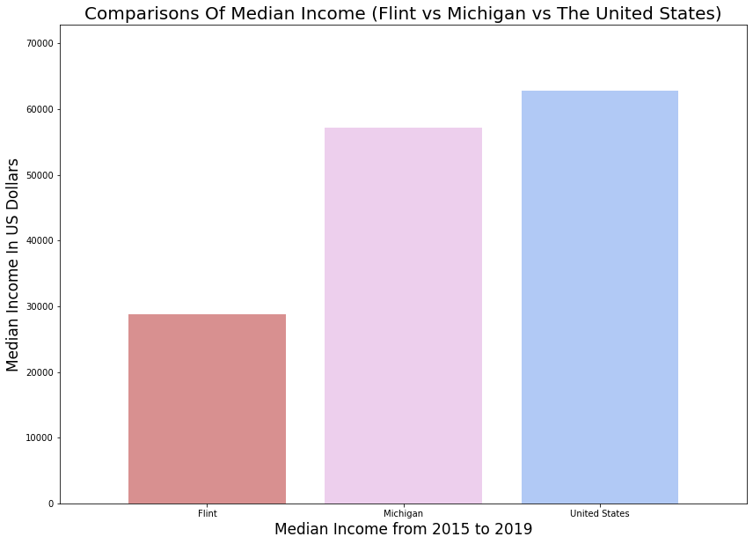

Slide 6
Comparisons of Median Income
The median income is the income amount that divides a population into two equal groups, half having an income above that amount, and half having an income below that amount.
Using median, rather than mean income, results in a much more accurate picture of the typical income of the middle class since the data will not be skewed by gains and abnormalities in the extreme ends.
Income is generally used as a measure of the economic well-being of individuals and communities. Median household income provides information about the financial resources available to households, and is closely tied to employment levels, educational attainment, and health.

Slide 7
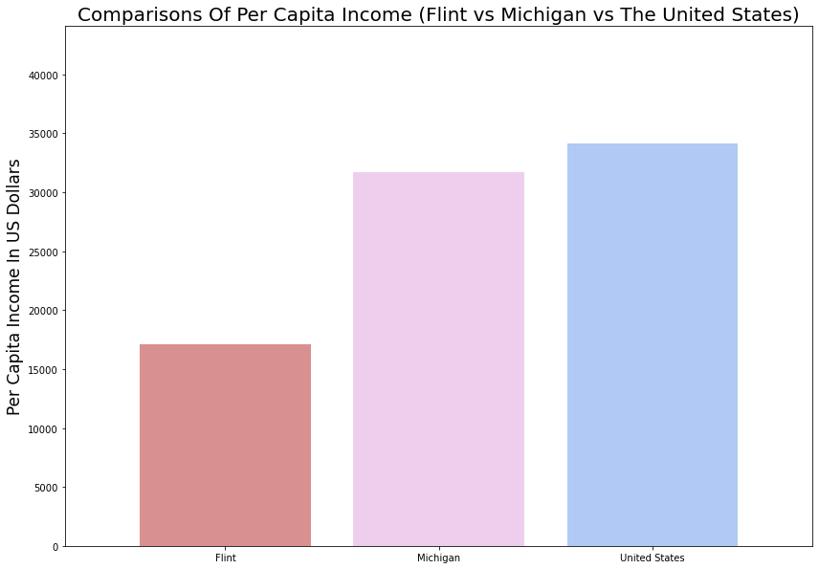

Slide 8
Per Capita Income
What Is Per Capita Income?
Per capita income is a measure of the amount of money earned per person in a nation or geographic region. Per capita income can be used to determine the average per-person income for an area and to evaluate the standard of living and “quality of life” of the population. Per capita income for a nation is calculated by dividing the country's national income by its population.

Slide 9
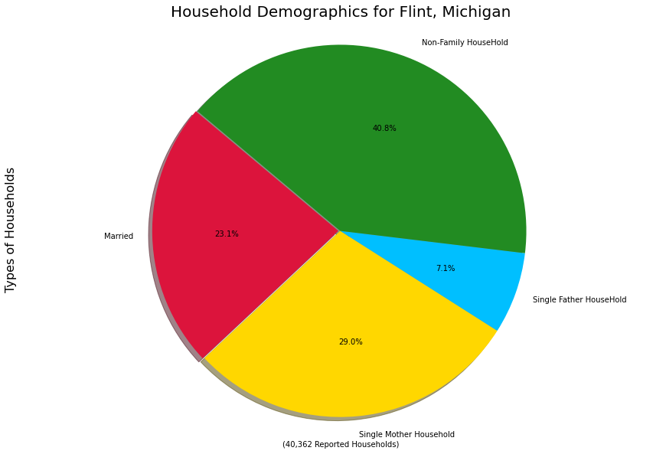

Slide 10
Household Demographics
Households and families are basic units of analysis in demography. They are not the same thing. A household is composed of one or more people who occupy a housing unit. Not all households contain families. Under the U.S. Census Bureau definition, family households consist of two or more individuals who are related by birth, marriage, or adoption, although they also may include other unrelated people. Nonfamily households consist of people who live alone or who share their residence with unrelated individuals.
Family demography is the study of the composition of families and of the transitions individuals make into and out of various types of families. Family composition includes factors such as the number of family members, their ages, marital and cohabitation status, and relationship to other family members.

Slide 11
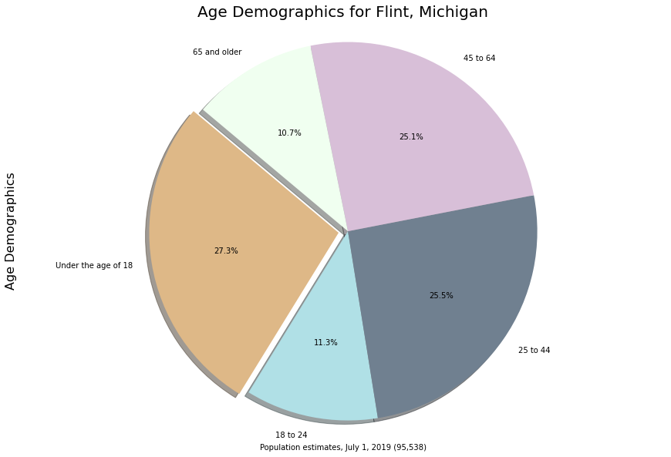

Slide 12
Why are Age Demographics Important in Research?
Age demographic information provides data regarding research participants and is necessary for the determination of whether the individuals in a particular study are a representative sample of the target population for generalization purposes

Slide 13
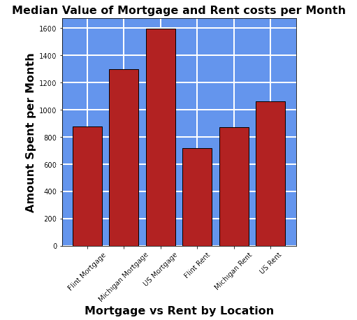
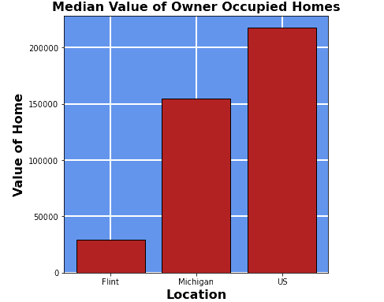
Housing

Slide 14
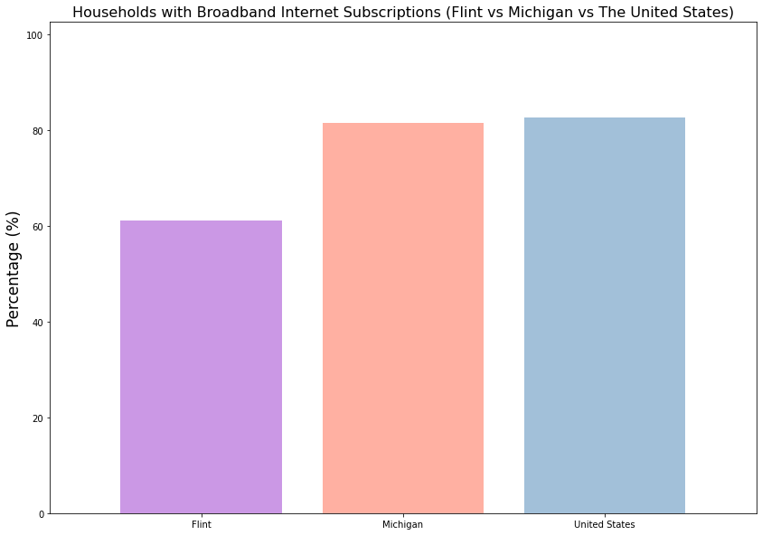

Slide 15
The Pros and Cons of the use of internet in the modern educational process
The Pros:
1)Research has been made easier
2)Students can interact with other students worldwide.
3)Enhance distance learning
4)Broaden students mind by exposing them to things outside their periphery.
5)Contributed to personalized learning, the teacher can easily control students time in tests
6)A student can learn life skills through the internet
7)Prepare the student for future deep-rooted technology

Slide 16
The Cons
1)Access to inappropriate content; pornography, crime etc.
2)The disconnect of students from the social interaction-the internet has created social anxiety on youths since they can only interact online and not face-to-face
3)Getting involved in cyberbullying
4)The Internet has enhanced cheating. Students Google almost every task.
5)The internet has distracted students in class activities. They are only glued to online games and social sites like Facebook and Instagram.
6)Lack of interest in studying: Technology has made every resource available anywhere anytime. This has resulted in students skipping classes because they already have the notes with them. Such students have made Google their teacher thus developing poor studying habits.
7)The internet has led to students developing a lazy attitude towards education, and most have even forgotten the nitty-gritty of studying. Most students who use computers often misspell words because they use spell checkers most of the times.

Slide 17
Why is health insurance important?
Health insurance covers essential health benefits critical to maintaining your health and treating illness and accidents. It allows you to get free preventive care, like vaccines, screenings, and some check-ups. Health insurance protects you from unexpected, high medical costs and out of pocket expenses.
Those who forgo health insurance, have to forgo other things when unexpected medical expenses arise.

Slide 18
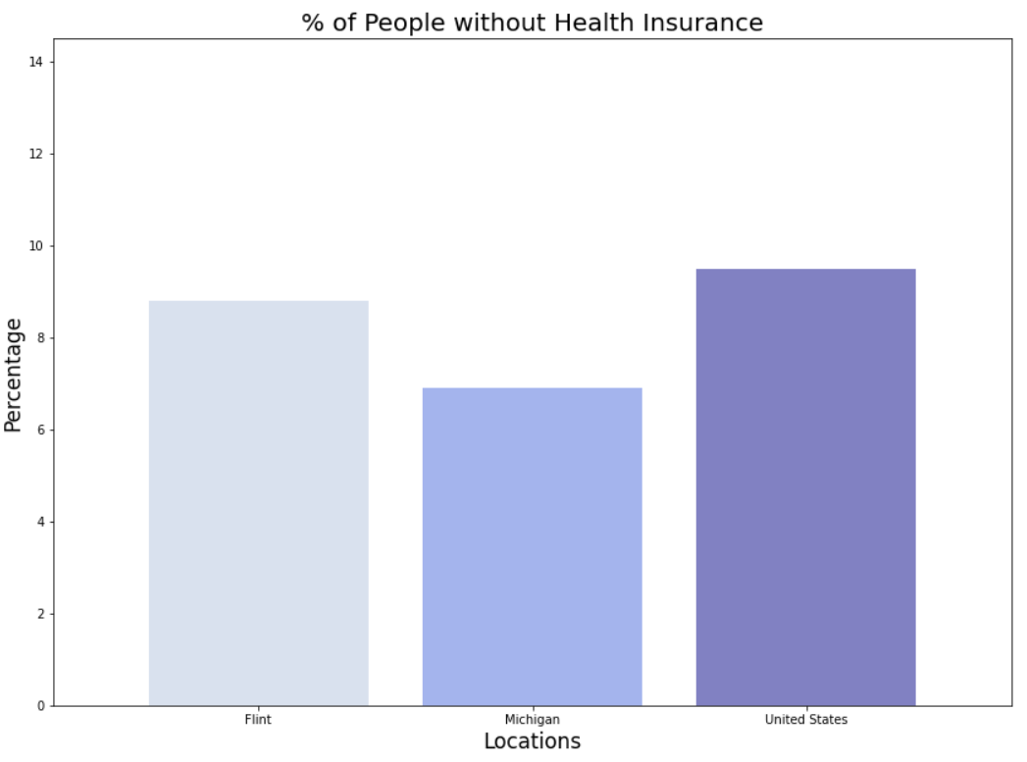

Slide 19
What is a disability?
A disability is any condition of the body or mind (impairment) that makes it more difficult for the person with the condition to do certain activities (activity limitation) and interact with the world around them (participation restrictions).
Some people with a disability are unable to work. While some of this population will receive state disability assistance, some will not qualify.

Slide 20
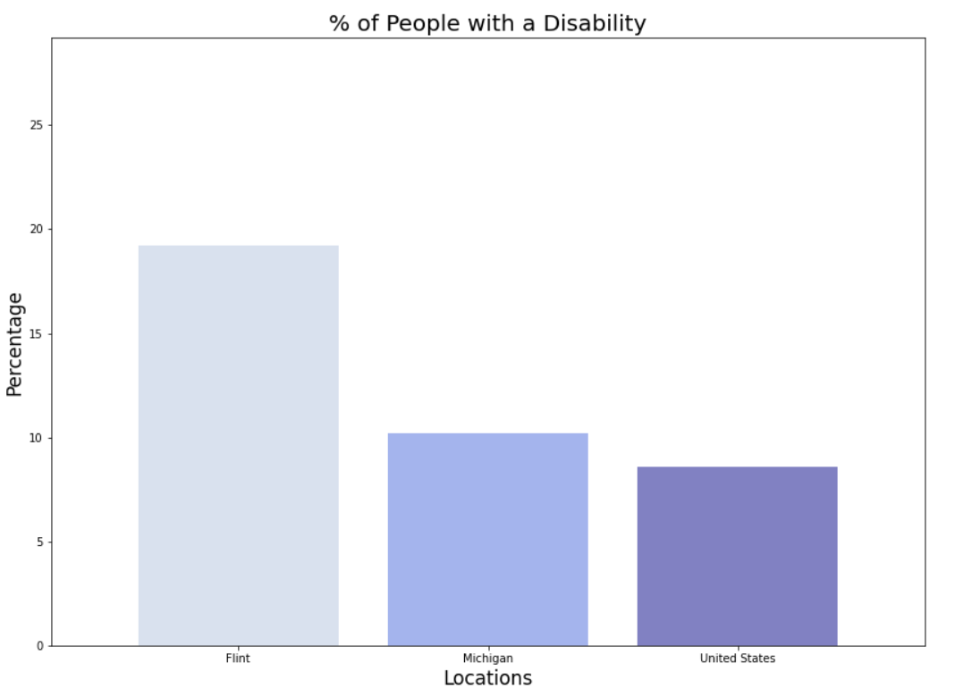

Slide 21
What Is Education?
Education means studying in order to obtain a deeper knowledge and understanding of a variety of subjects to be applied to daily life. Education is not limited to just knowledge from books, but can also be obtained through practical experiences outside of the classroom.
An education is important because it helps build character, intellect, and opinions. Education helps build confidence, fosters critical thinking, and provides knowledge. An education often times helps to create opportunities for individuals.

Slide 22
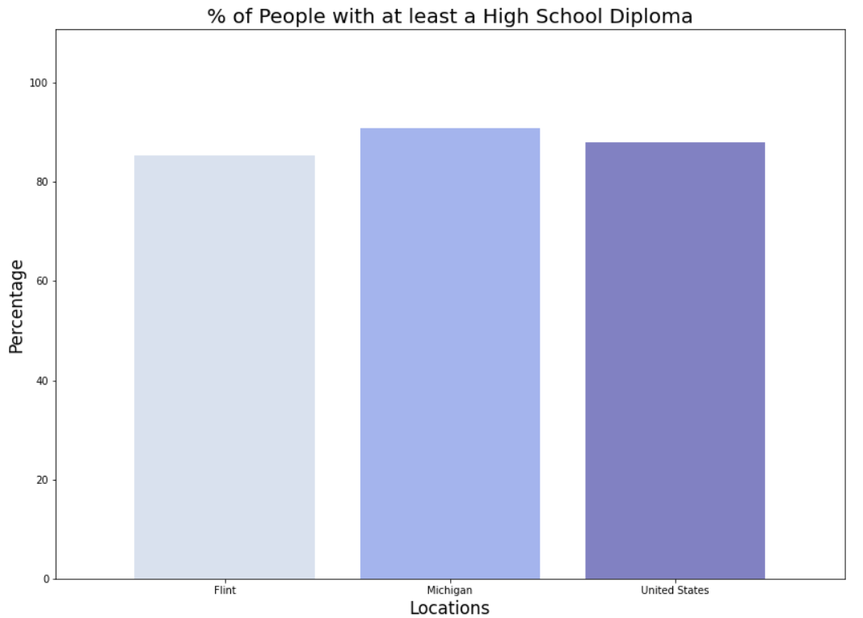

Slide 23
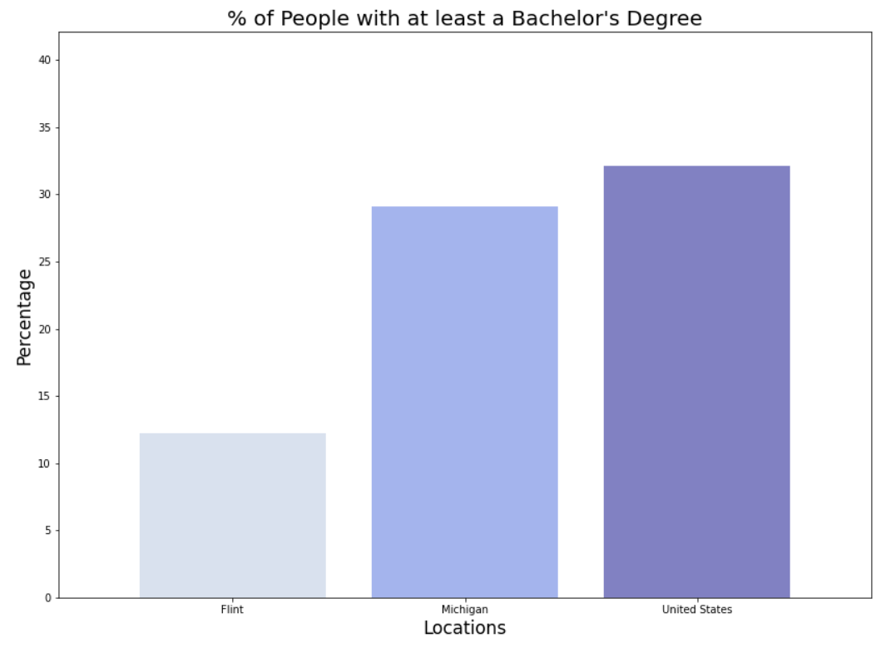

Slide 24
Poverty
Poverty is measured in the United States by comparing a person's or family's income to a set poverty threshold or minimum amount of income needed to cover basic needs. People whose income falls under their threshold are considered poor.

Slide 25
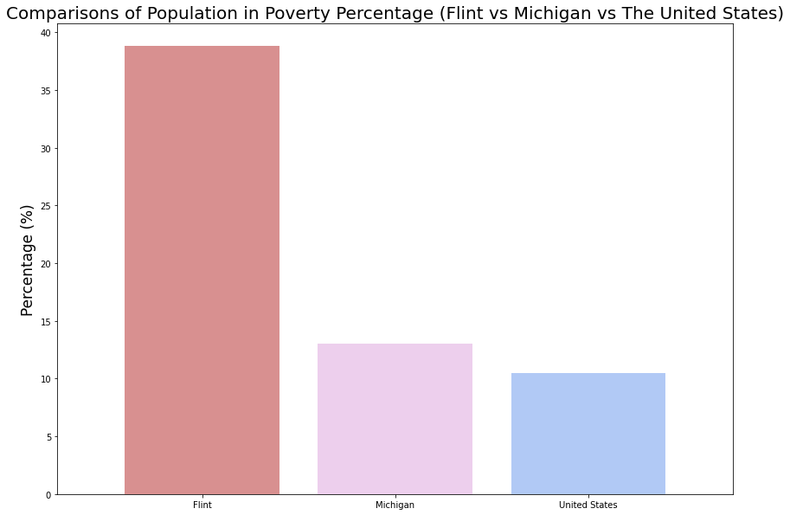

Slide 26
In Conclusion
"Poverty cannot is not hinged on one lone factor, but all of these areas show the effects that poverty has had on this city and in turn what continues to keep the people of Flint Michigan in poverty.

